Slide 1
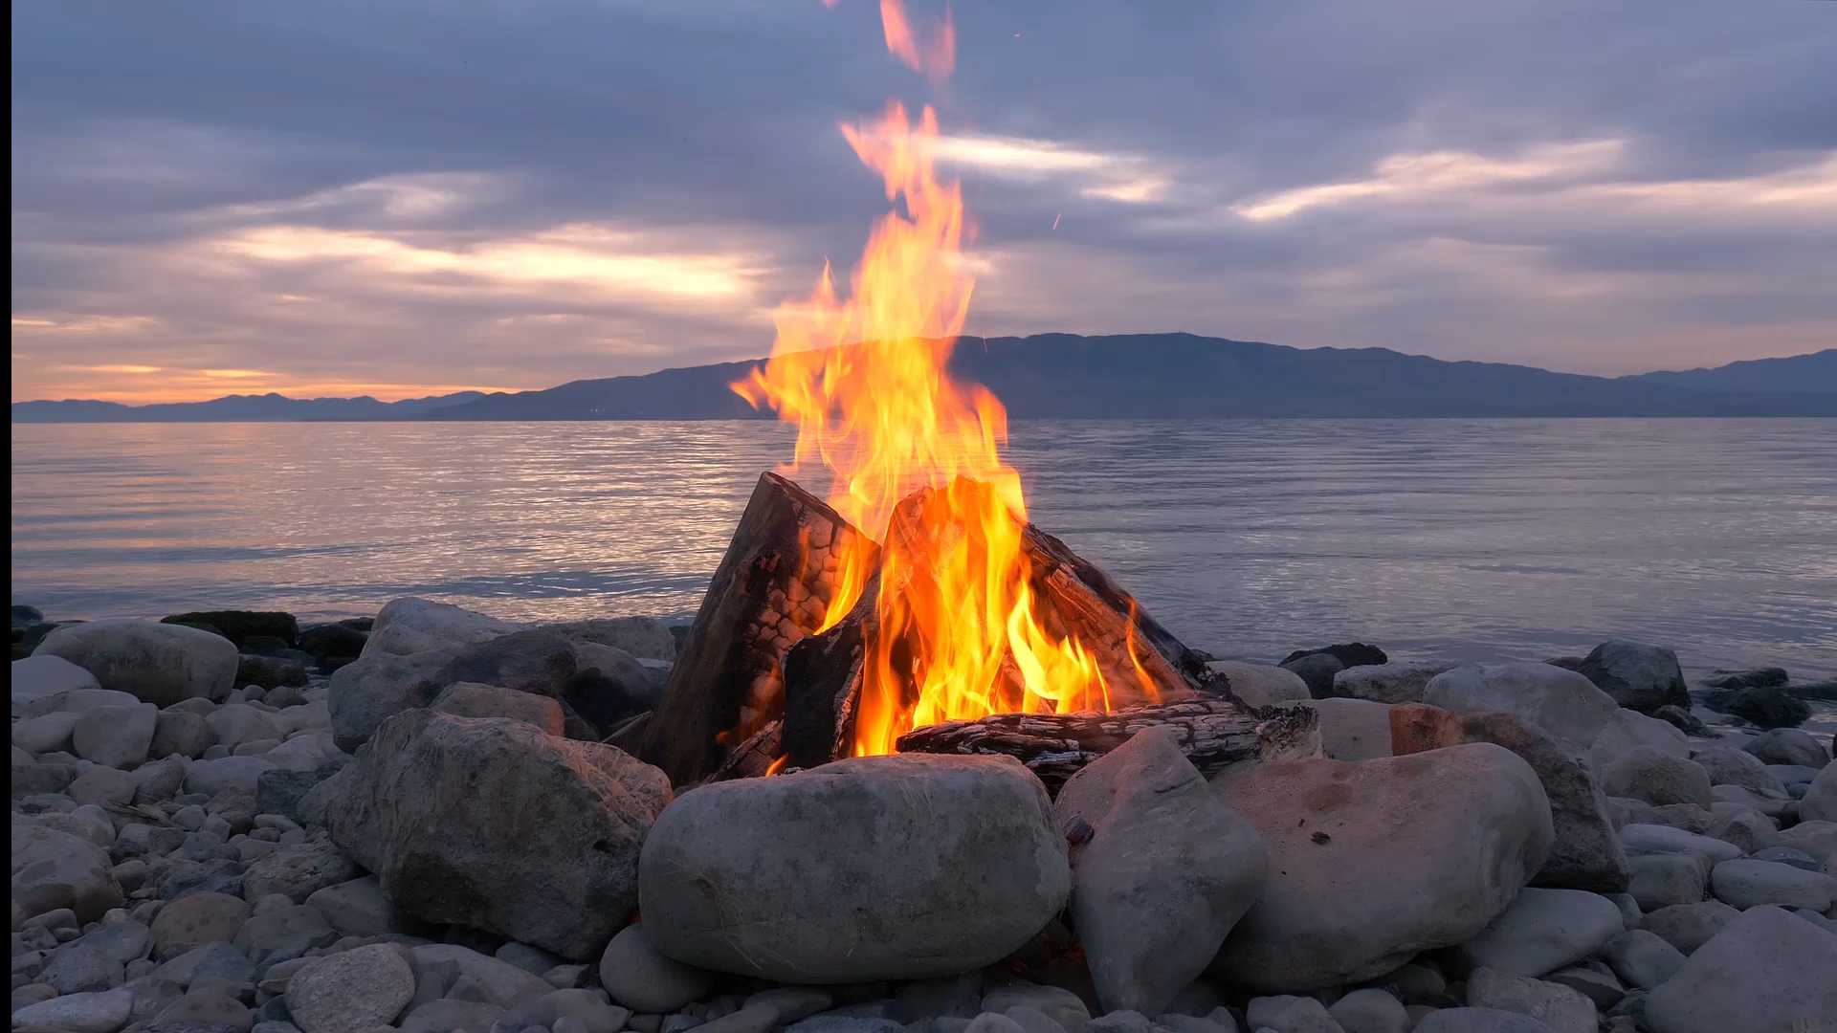
Wildfire Data Analysis
Josiah
Steven
Jose

Slide 2
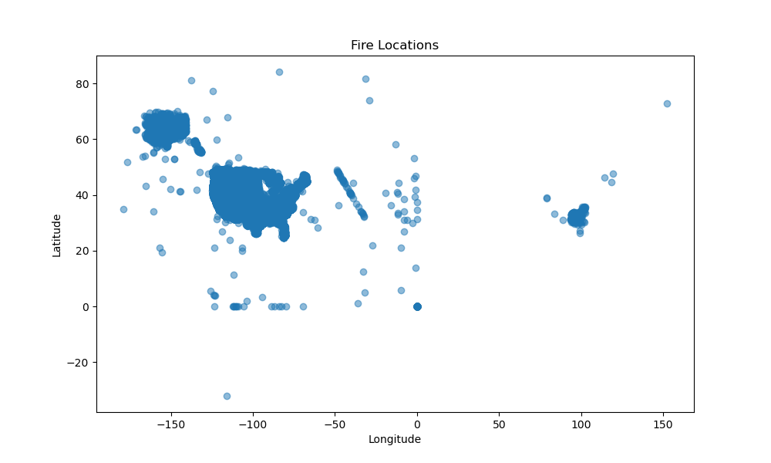
Scatter plot of fire locations based on longitude and latitude
Between what latitudes and longitudes do we see the highest occurrence of fires?

Slide 3
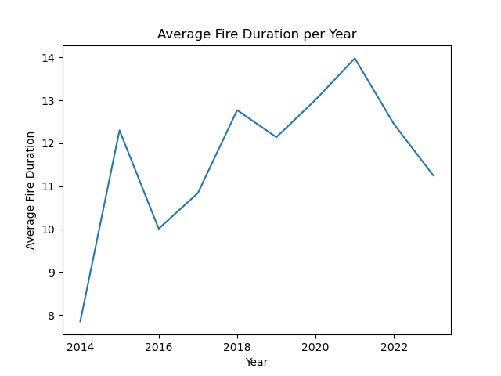
Line graph for Average fire duration per year in days
What was the average fire duration from 2014-present?

Slide 4
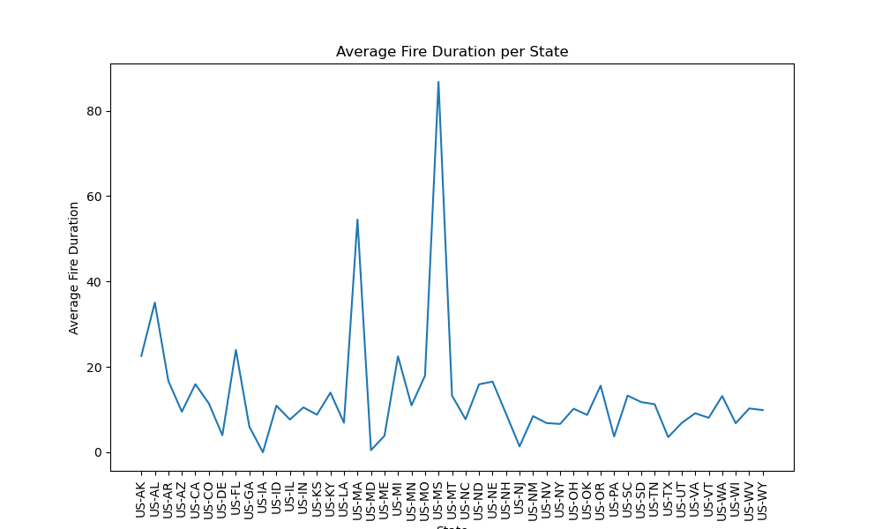
AVERAGE FIRE DURATION PER STATE
What was the average fire duration per state?

Slide 5
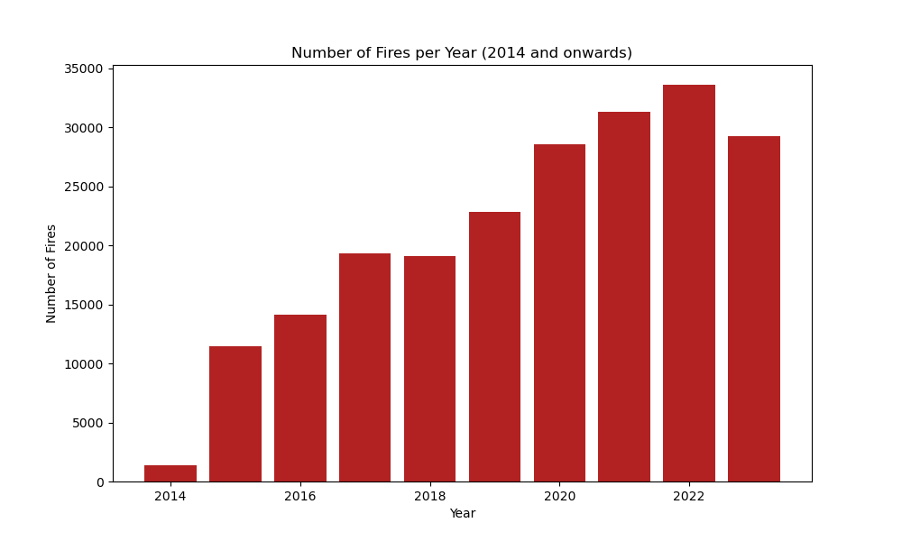
Bar graph of number of fires per year
What was the trend of frequency of fires grouped by year?

Slide 6
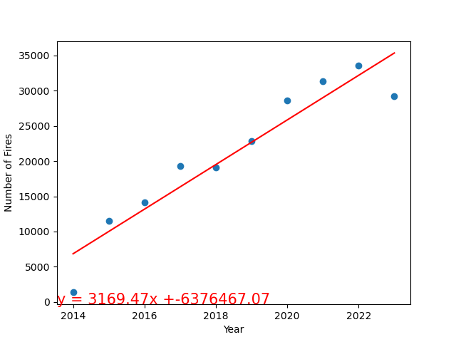
Linear Regression on fires per year
R = .8972, Strong positive relationship
What was the trend of frequency of fires grouped by year?

Slide 7
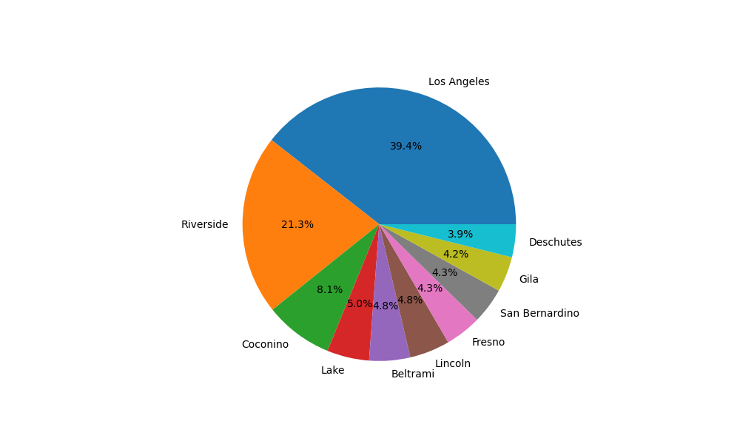
Top counties pie graph
What counties had the most fires?

Slide 8
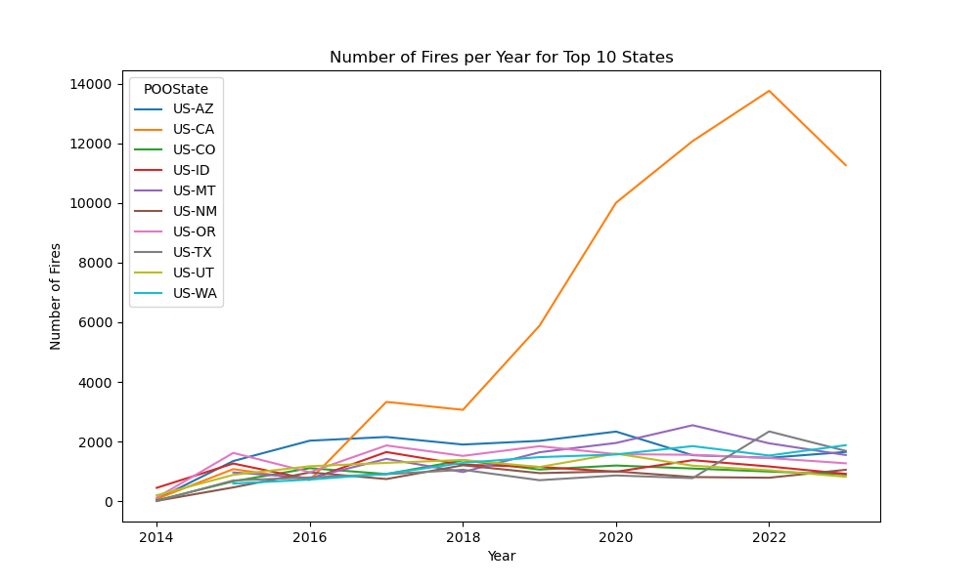
Line graph for number of fires in the top 10 states
What are the top ten states that have the greatest number of fires, cumulatively?

Slide 9
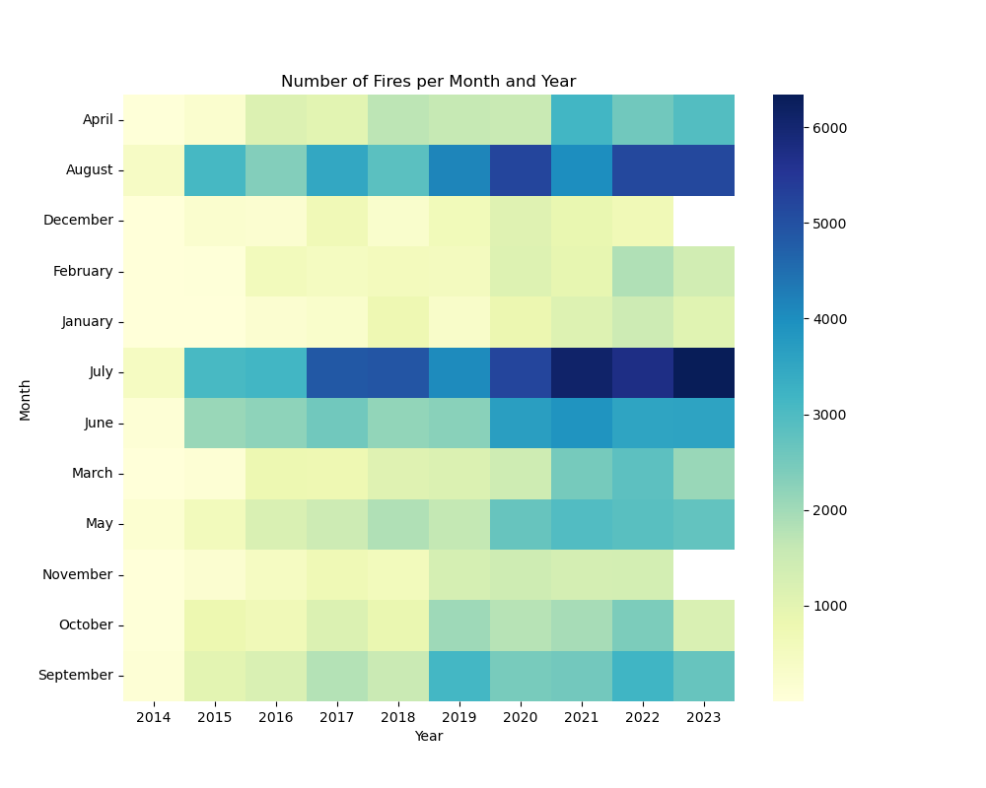
Heat map of number of fires per month
What months do the most fires occur?

